Slide 1
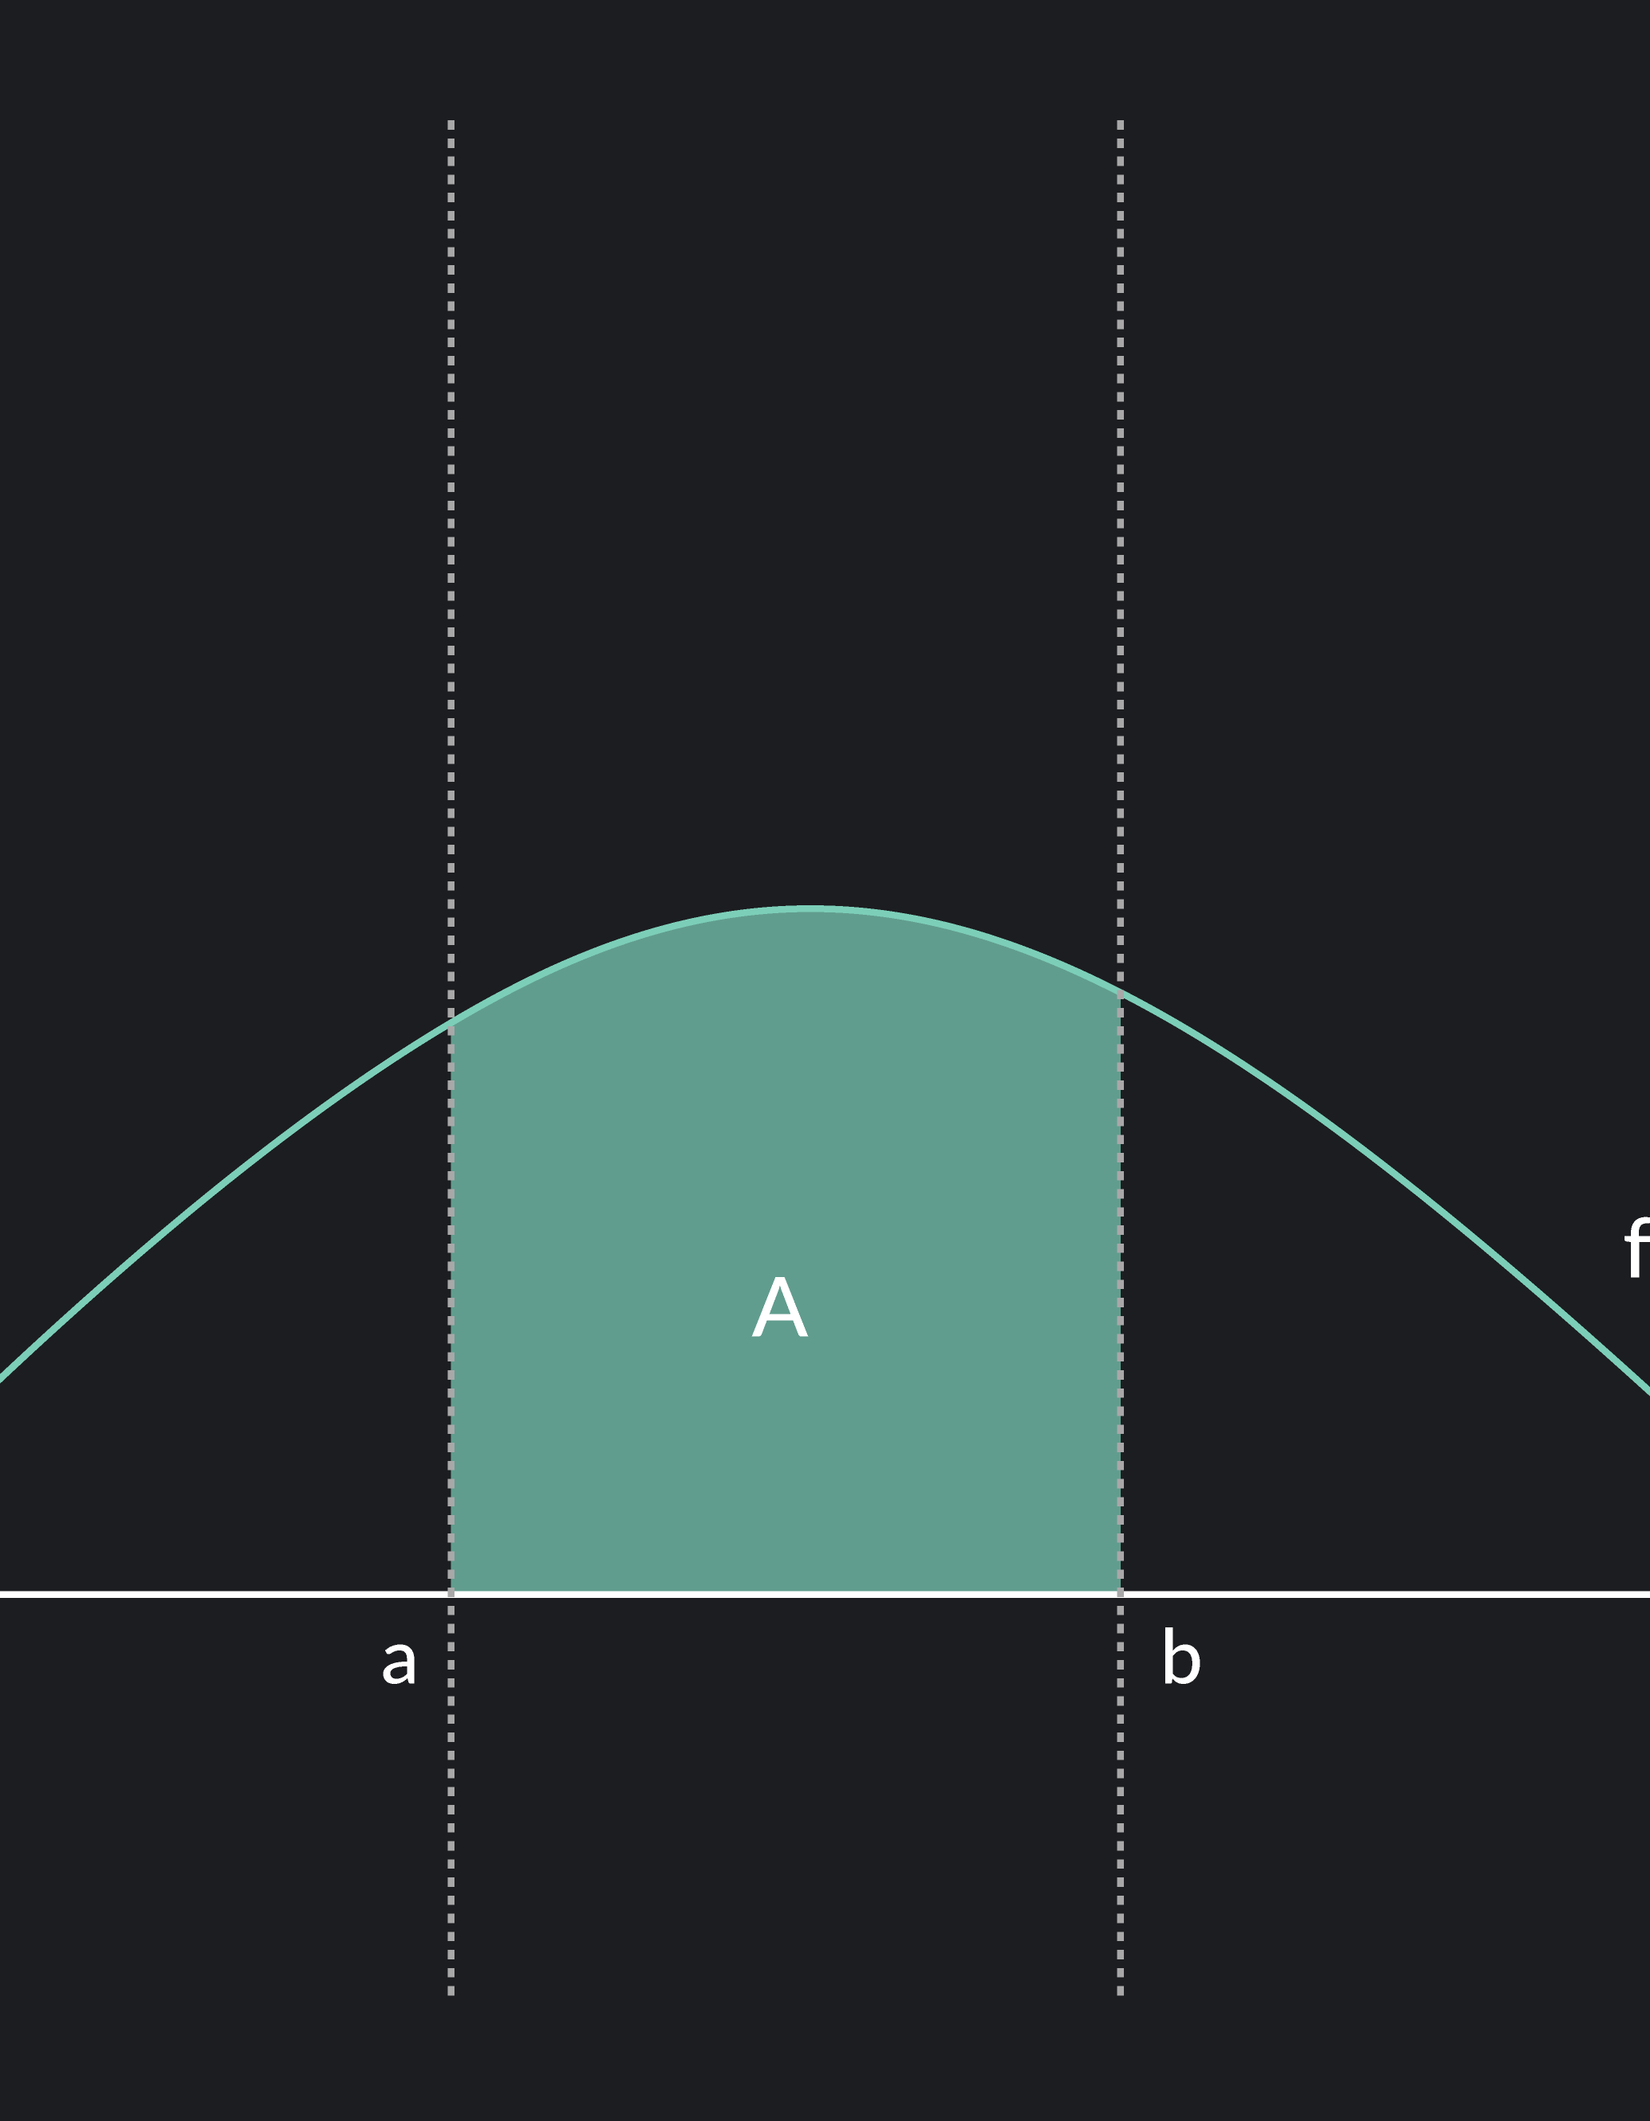
Applications of Definite Integrals
Arooba Shehzadi
231678

Slide 2
OUTLINE:
1
2
3
4
5
Introduction
Applications
Drug Concentration Over Time
Code and graphs
Summary

Slide 3
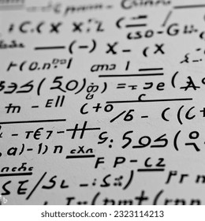
Introduction
Definite integrals are powerful tools for solving real-world problems. They calculate areas, volumes, and accumulated changes, enabling solutions across fields like renewable energy, AI, and finance.

Slide 4

Application

Slide 5





MODERN APPLICATIONS USED NOW A DAYS
Solar Energy Collected Over Time
Calculating the total energy harvested by solar panels over a day
Transportation:
Measuring the distance a vehicle travels during a trip based on its speed profile.
Total Rainfall Over Time:
Measuring total rainfall in a region over the course of a storm.
Modeling Population growth:
Definite integrals are used to model population growth over time,
often when the growth rate is a function of time.
Stock Price Movement:
Analyzing stock price trends over a specific time period to
evaluate growth.

Slide 6
PRACTICAL REVIEW OF APPLICATION
“
Drug Concentration Over Time
”

Slide 7
OverView
Definite integrals help compute the total drug effect in the bloodstream by integrating the drug concentration curve over time. This aids in determining optimal dosages.

Slide 8
CODE:
import numpy as np
from scipy.integrate import quad
import matplotlib.pyplot as plt
from tkinter import Tk, Label, Entry, StringVar, messagebox, Frame
from tkinter.ttk import Button, Style # Use ttk.Button instead of tkinter.Button
Explanation:
numpy: Used for numerical operations, like creating time points.
scipy.integrate.quad: Integrates the function for total drug effect.
matplotlib: Plots the drug concentration graph.
tkinter and ttk: Used for building the GUI (Graphical User Interface).

Slide 9
MAIN FUNCTIONS:
Drug Concentration Function
Plot Concentration Function
Reset Function
def reset_fields():
dose_var.set("50")
rate_var.set("0.1")
start_var.set("0")
end_var.set("12")
points_var.set("100")
messagebox.showinfo("Reset", "All fields have been reset.“)
Explanation:
Purpose: Resets all input fields to their default values.
Default Values:
Dose: 50
Elimination rate: 0.1
Start time: 0
End time: 12
Intervals: 100
Message: Confirms that fields have been reset.
def drug_concentration(t, dose, elimination_rate):
"""Compute the drug concentration at time t."""
return dose * np.exp(-elimination_rate * t)
Explanation:
Purpose: Calculates drug concentration at a specific time t.
Formula: 𝐶(𝑡)=dose×𝑒−elimination rate×𝑡C(t)=dose×e ^ elimination rate×t
def plot_concentration(): ///
........
Explanation:
Input Handling:
Reads user input (dose, elimination rate, time range, intervals).
Calculate Concentration:
Creates time points using np.linspace.
Computes drug concentration using the drug_concentration function.
Plotting:
Plots the curve and shades the total effect area.
Error Handling:
Displays error messages if inputs are invalid.

Slide 10
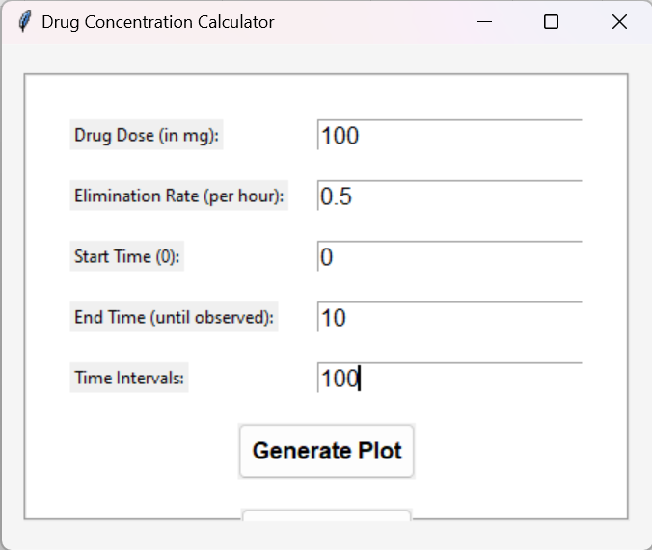
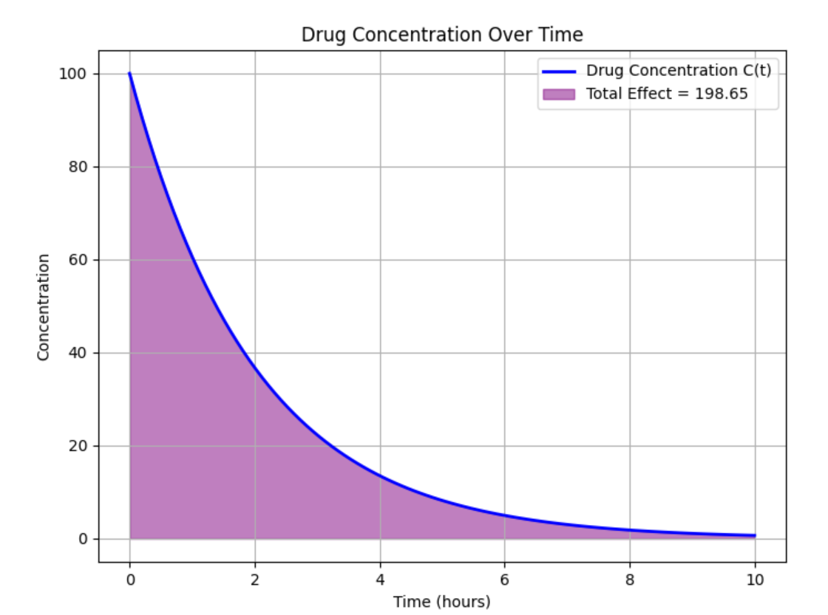
EXPLANATION
OF GRAPH:

Slide 12
APPLICATIONS:
1. Determining the Total Drug Dose in the Body
3. Predicting Drug Interaction and Cumulative Effects
5. Monitoring and Adjusting for Renal or Hepatic Impairment
2. Calculating Half-Life and Clearance Rate
4. Optimizing Drug Dosage and Administration

Slide 13

Conclusion:
WHERE THERE’S LIFE THERE’S INTGRATION

Slide 14

Thank you
Arooba Shehzadi
BSCS-3B
231678

